Slide 1
Chapter 2.2
Refrigeration and air conditioning

Slide 2
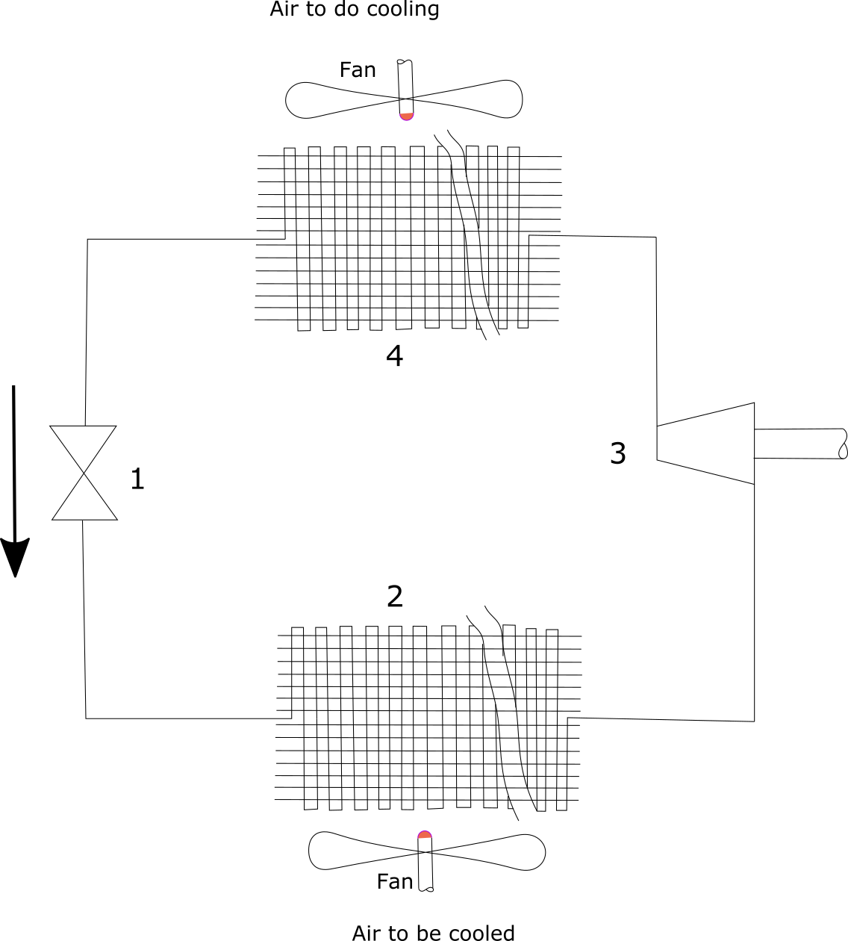
Schematic of heat pump
Throttle
Evaporator
Compressor
Condenser

Slide 3
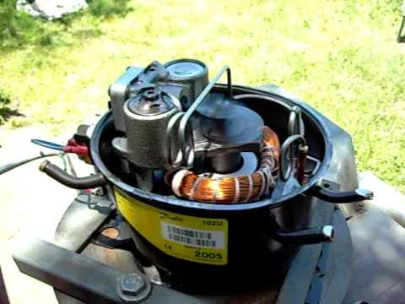
Refrigerant compressor – move refrigerant from low to high pressure
You may be interested to see: https://www.youtube.com/watch?v=3Uwx-_VecHo

Slide 4
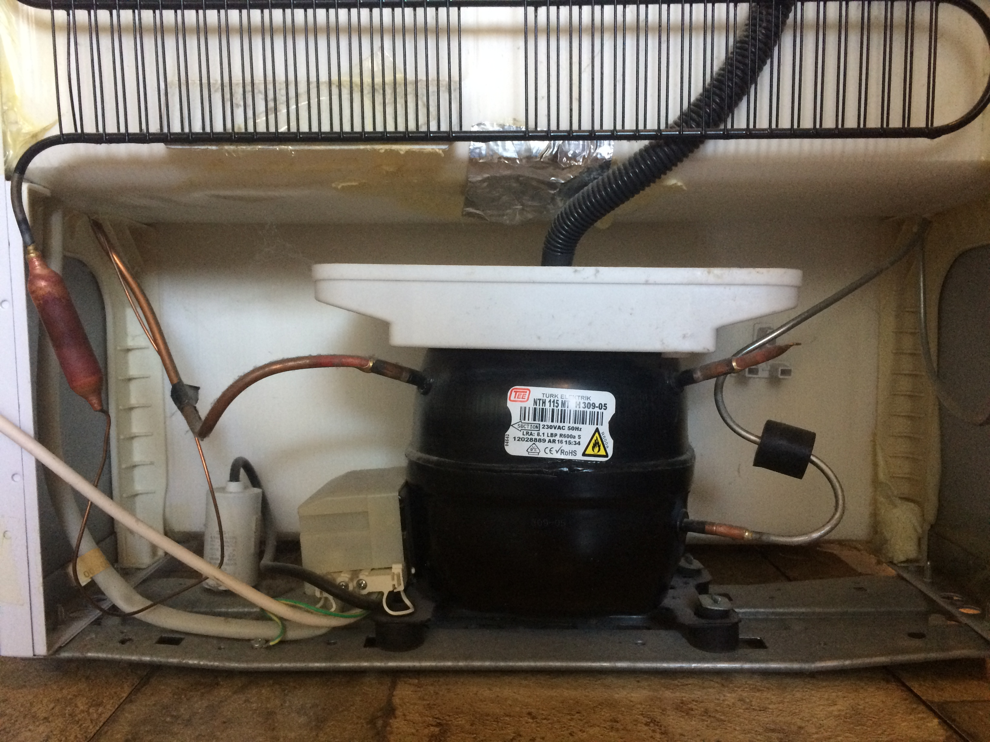
Refrigerator compressor

Slide 5
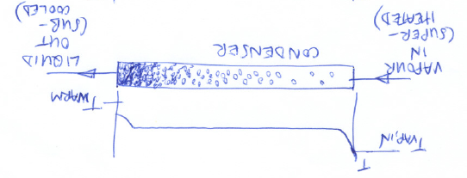
Condenser heat exchanger
Condenser heat exchanger.
Vapour enters condenser at temperature above t high and exchanges heat, Q out of condenser to cool the vapour.
The vapour condenses when it reaches t sat until all is condensed.
T sat needs to be a few degrees above the t of the hot reservoir to work properly.

Slide 6
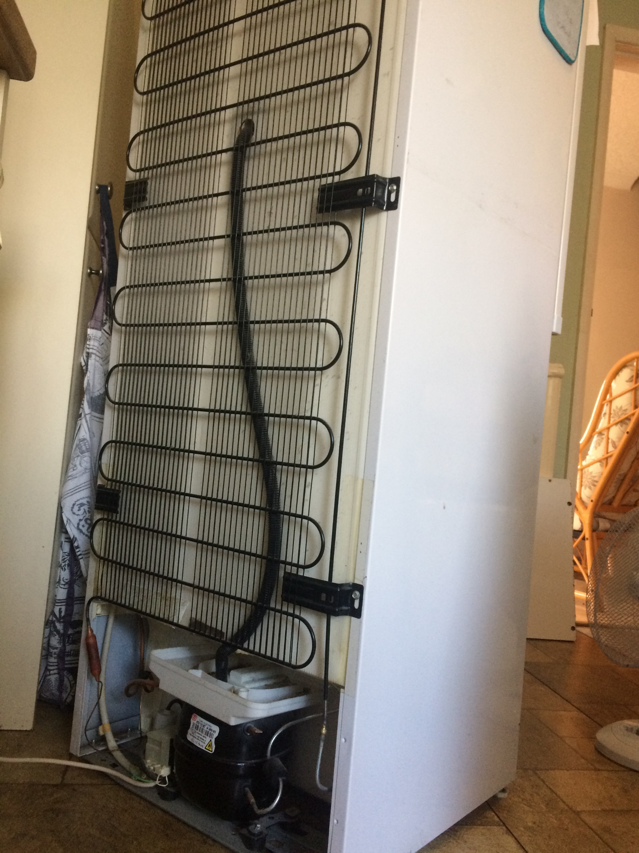
A refrigerator condenser heat exchanger and compressor in the base.

Slide 7
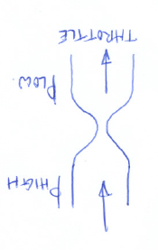
throttle
Throttle
The condensed and slightly sub cooled liquid passes through the throttle. This reduces the pressure of the fluid and therefore the t sat reduces to a point just below the cool reservoir (which contains the evaporator) temperature.

Slide 8
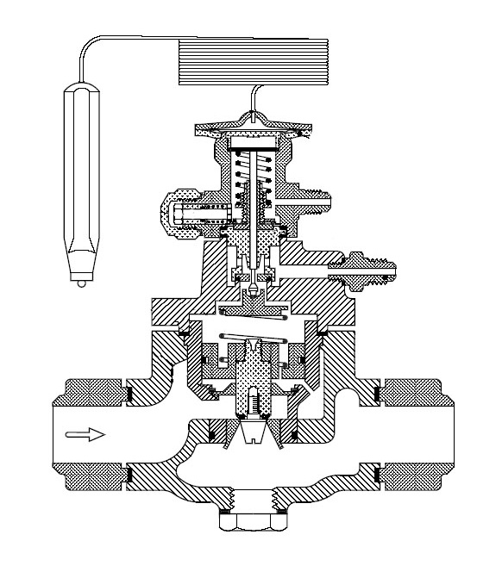
Refrigerant throttle – restricts refrigerant from high to low pressure
Thermostatic expansion valve used to control the flow of refrigerant from the high pressure side to the low pressure side
By Neurotronix - Own work, CC BY-SA 4.0, https://commons.wikimedia.org/w/index.php?curid=8015906

Slide 9
How the throttle has no change in enthalpy across it
We know that the throttle is short and should be well insulated (it often is NOT at all well insulated!!), and so Q is zero. There is obviously no work – no paddles, pistons, hands etc.
Use the SFEE, where Q and W are rates of heating and power input and m is the mass flow rate. It is easy to see that if Q and W are zero, then the enthalpy entering is the same as that leaving.
Physically this is a LOT harder to understand because of the complex fluid dynamics going on.

Slide 10
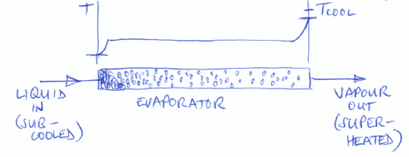

evaporator
Evaporator
As it enters the evaporator, liquid heats up to t sat and starts to boil.
By the time it reaches the end of the evaporator, all is evaporated and the vapour gains a little superheat.

Slide 11
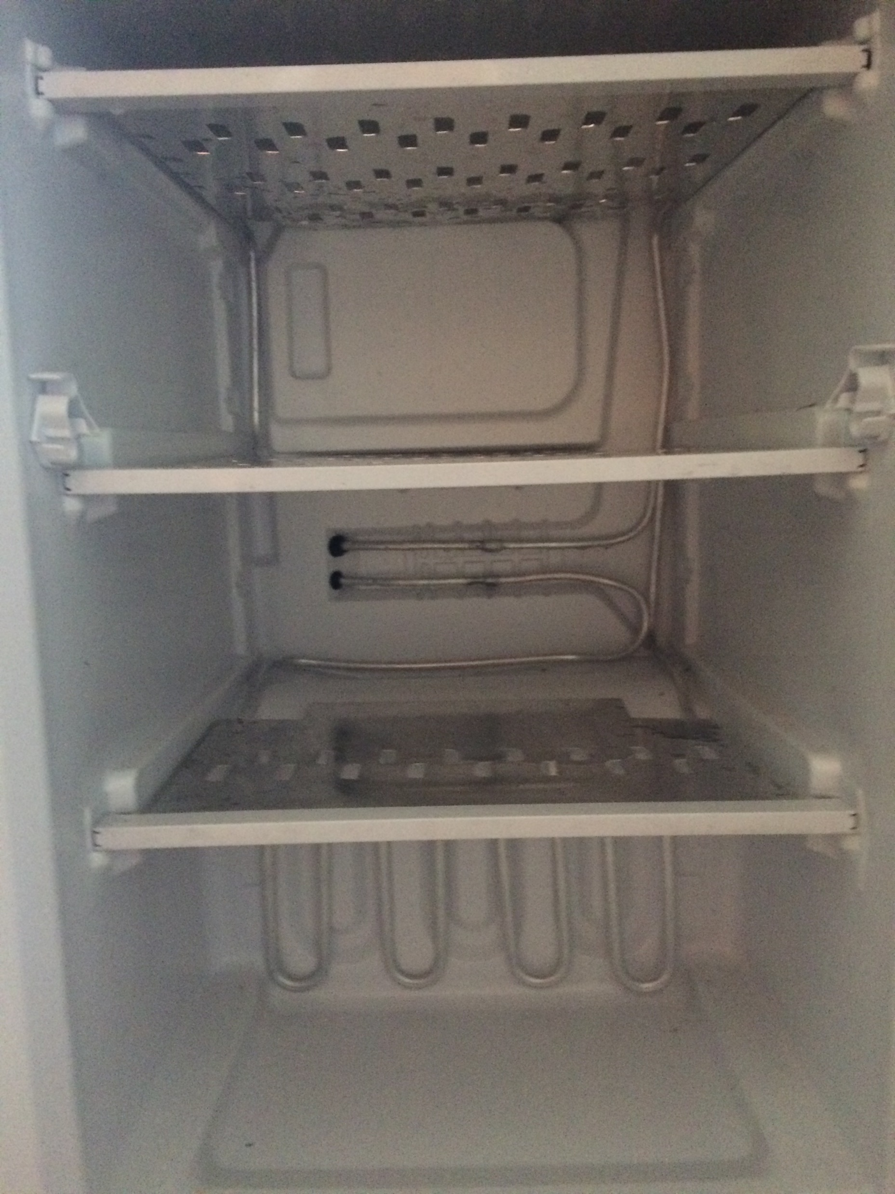
Evaporator heat exchanger coils

