Slide 1
Chapter 2
Refrigeration and air conditioning

Slide 2
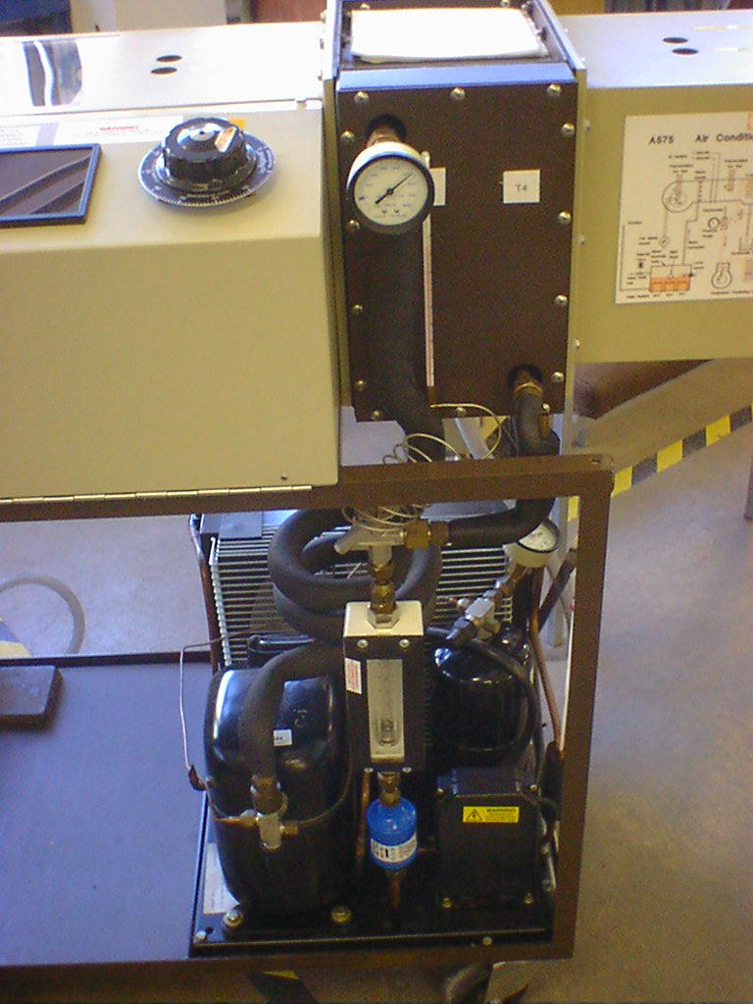
Chapter 2.1: Refrigeration
A source of cold is required for many human activities – keeping fresh food for extended times, air conditioning in uncomfortably hot environments, slowing down processes, and keeping chemicals stable, etc. Since cold occurs in nature only by location and specific times, mechanical refrigeration is used globally to apply cold where we need it.
Condenser, hot
Evaporator, cold
Throttle, pressure reduced
Compressor, work
Air Conditioning Demonstrator
Refrigeration
Notes:
I’ve marked on the process – has a condensing hot reservoir, an evaporating cold reservoir – a compressor and a throttle.
Description of what is going on:
The evaporator is maintained at a low pressure by the compressor inlet side; therefore p is low and t _{boil} is correspondingly low so that the liquid in this chamber evaporates.
The compressor drives the evaporated vapour through to the higher pressure condenser on the left hand side. The high pressure means high p and therefore high t_{boil} and the vapour is forced to condense.

Slide 3
Learning outcomes -refrigeration
Explain meaning of heat pump for positive and negative heat transfer
Describe the basic reverse Carnot cycle vapour-compression refrigeration cycle
Awareness of various refrigerants, and of R134a in particular and that they have different ranges of temperature
Plot the vapour compression refrigeration cycle on a p-h diagram

Slide 4
Heat pumps and refrigerators
A heat pump is a thermodynamic machine, which uses work to extract heat from a low temperature source, and deliver it to a high temperature sink.
A refrigerator is a heat pump - heat extraction from the low temperature source is the purpose.
Since heat transfer is the objective, the effectiveness of heat pumps is measured as the ratio:

Slide 5
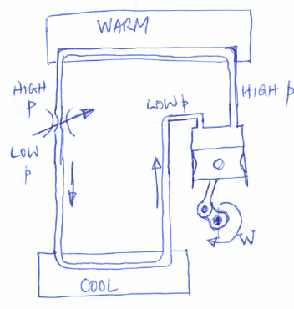
Heat pump schematic
A heat pump is a device that drives a fluid around a process, by which heat is transferred from a cool place to a hot one. This is achieved by applying work!
Warm
Condenser, p high, T high
Q_{high}
W_{in}
Q_{low}
Cool
Q_{high} – Q_{low} = W_{in}
Evaporator, p low, T low
Notes:
The difference between Qhigh and Q low is the work input.
On the left the heat in and out are global to the system, which is considered as an engine.
On the right the SFEE can be used at any section where there is a change to relate energy content of the fluid to the heat or work that happens to it.

