Slide 1
Compressible flow and turbomachinery and guest content: nuclear power generation

Slide 2
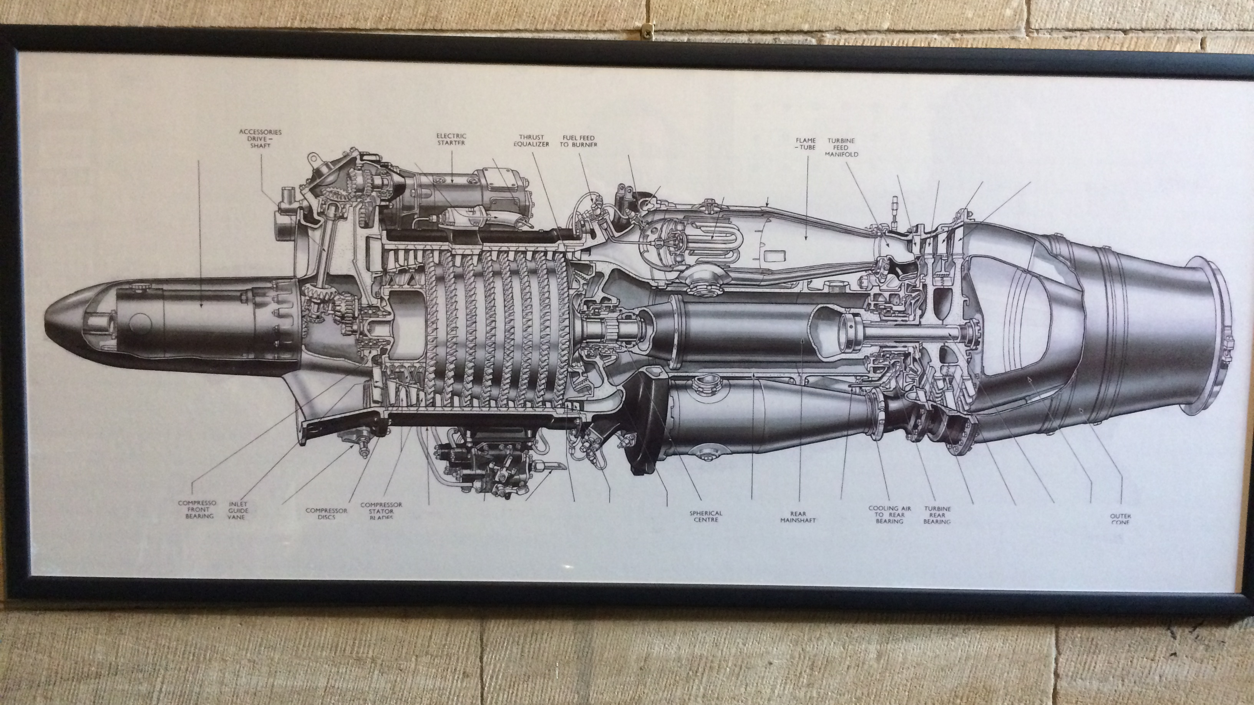
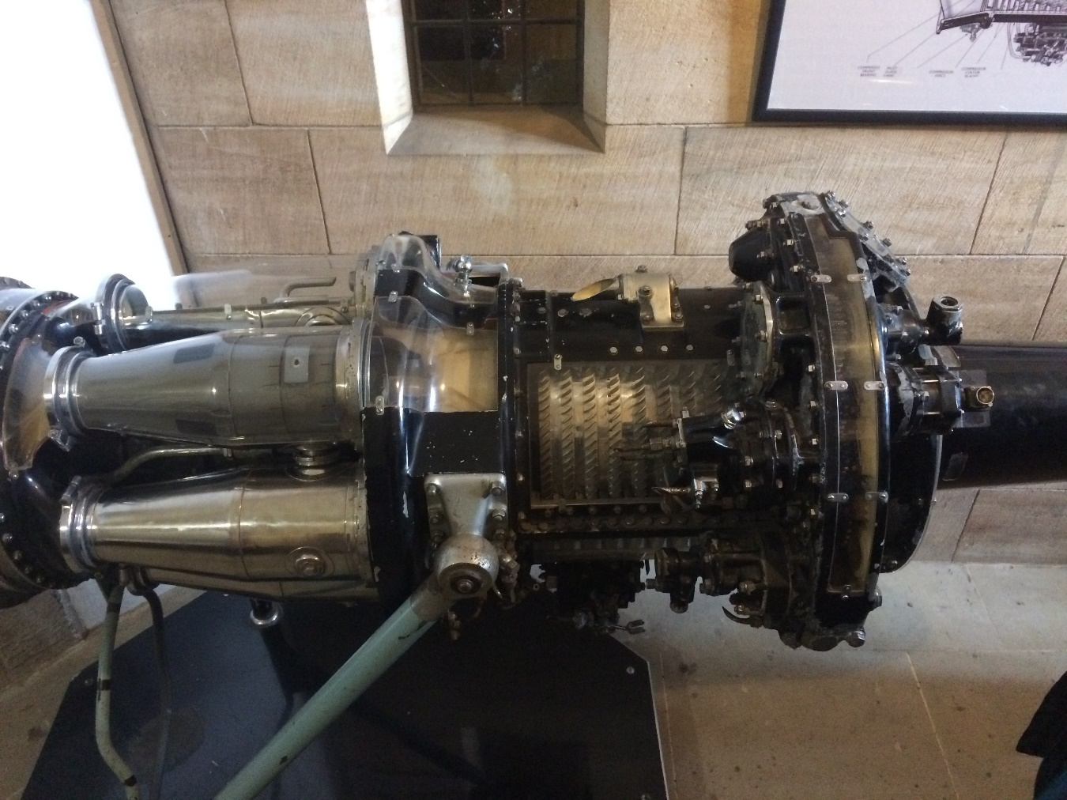
Fluid compressed, fluid heated, fluid expanded, all in contained annular axisymmetric channel with aerodynamic flow components.
High velocity is likely and compressible flow must be considered.
Turbines produce power; nuclear power is visited briefly as a ‘guest’ lecture.

Slide 3
Structure
Aim: explore the nature of turbomachines and compressible flow to gain a practical understanding of the connection of thermodynamics and fluid mechanics within mechanical power transformations.
Objectives:
connection of this section with previous study in thermofluids;
effects of compressible flow within turbo compressors and turbines;
normal and oblique shocks;
Prandtl-Meyer waves;
develop the Euler turbine equation and describe the connection with reaction;
velocity diagram methodology;
flow in axial turbomachines with analysis of the velocity and reaction;
overview of radial flow turbomachines and the variation of the analysis from axial flow machines;
introduction to nuclear power.

Slide 4
Supported case study
A CFD case will be provided with two basically solved compressible flow cases. A guided task will derive explanations of what is seen in the models by extracting data using the post processing tools in Fluent, followed by offering explanations of the observations according to compressible flow theory and detailing effects that the compressible flow will have if encountered in turbine and compressor flows.
An excel based turbine cascade design will explore the ideas for basic design of an axial flow turbine from the guide given in the lectures.

Slide 5
Content of this section, necessary, optional
supersonic flow interaction with inclined surfaces (oblique shocks) in the case of compressing and expanding flows
internal compressible flows with friction and heat addition
guided investigation of a compressible flow CFD case
flow through rotor and stator cascades in compressors and turbines
aspects of axial flow machines
cascade flow passage design methods introduction for axial flow machines
guided investigation of a turbine cascade design
factors for consideration in radial and mixed flow machines
Guest lecture (for the extra enthusiastic only): Nuclear engineering

Slide 6
Nuclear power generation – a ‘guest lecture’, not a guest lecturer…. You may review the material if you wish
Nuclear power is considered as part of the power generation mix
Power generation is generally by pressurised water reactors (PWR), which have a high pressure water circuit on the reactor core and a heat exchanger to a steam raising plant for the turbines, or boiling water reactors (BWR), which generate the turbine steam directly from the reactor core
Nuclear energy generation depends on fission, which is controlled by the rate of moderation (slowing down) of neutrons from reactions to thermal speeds, above which fission does not occur
Control of nuclear reactors depends on moderation of neutrons and relying on delayed neutron release, which are controlled by water flow rate in the BWR and by a boric acid cycle in the PWR

